Slide 1
Age and Gender detection
By Using OpenCV Package in Python
- By Lakshmi Piya

Slide 2
Objective:
To build a gender and age detector that can approximately guess the gender and age of the person (face) in a picture using the deep learning.

Slide 3
About project :
In this project , we will use deep learning to accurately identify the gender and age of a person from a single of image.
We will trained model for this particular target.
The predicted gender may be one of “ male ” and “ female ”, and the predicted age one of the following ranges- (0 – 2), (4 – 6), (8 – 12), (15 – 20), (25 – 32), (38 – 43), (48 – 53), (60 – 100)
It is very difficult to accurately guess an exact age from a single image because of factors like makeup, lighting, obstructions, and facial expressions. And so, we make this a classification problem instead of making it one of regression.

Slide 4
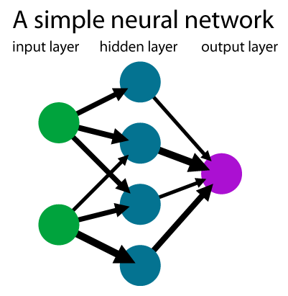
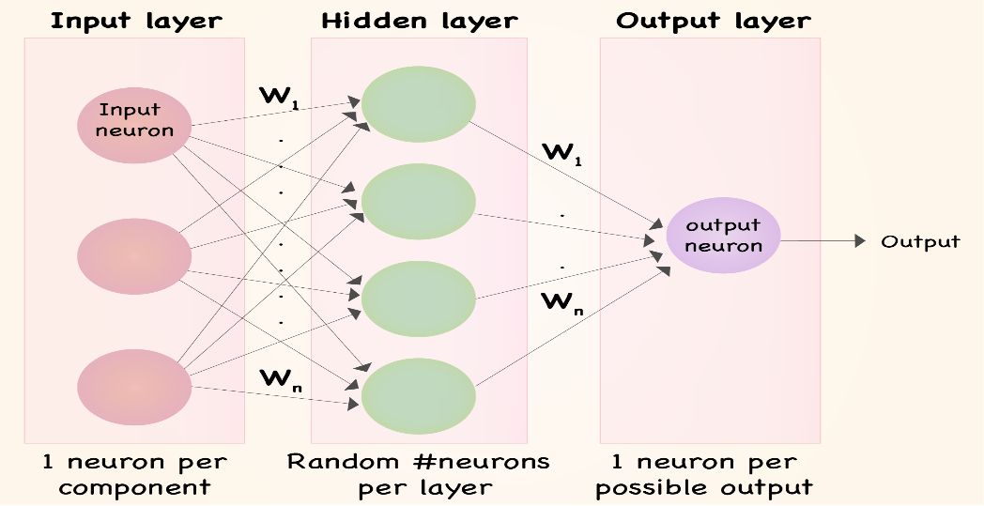
NN

Slide 5
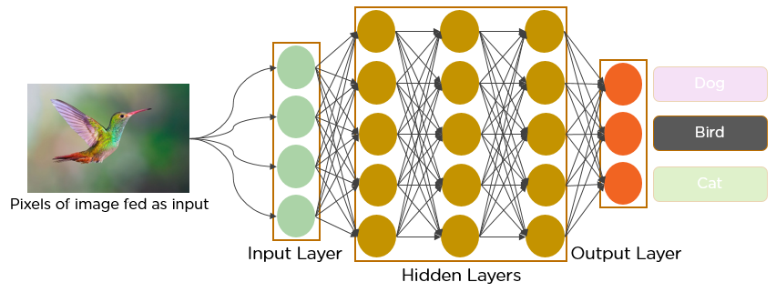
CNN

Slide 6
Steps of project :
Detect the faces
Classify into male /female
Classify into one of the 8 age range
Put the result on the image and displays it.

Slide 7
The dataset :
For this project: the data set available in the public domain and you can find
https://www.kaggle.com/ttungl/adience-benchmark-gender-and-age-classification
The face photos collected from various real world imaging condition like noise,lighting, pose and appearance.
It has a total 26,580 photos of 2284 subject in eight age range.
The model have be trained by this dataset only.

Slide 8
Used file:
Face detection:
opencv_face_detector.pbtxt
opencv_face_detector_uint8.pb
Age detection:
age_deploy.prototxt
age_net.caffemodel
Gender detection:
gender_deploy.prototxt
gender_net.caffemodel

Slide 9
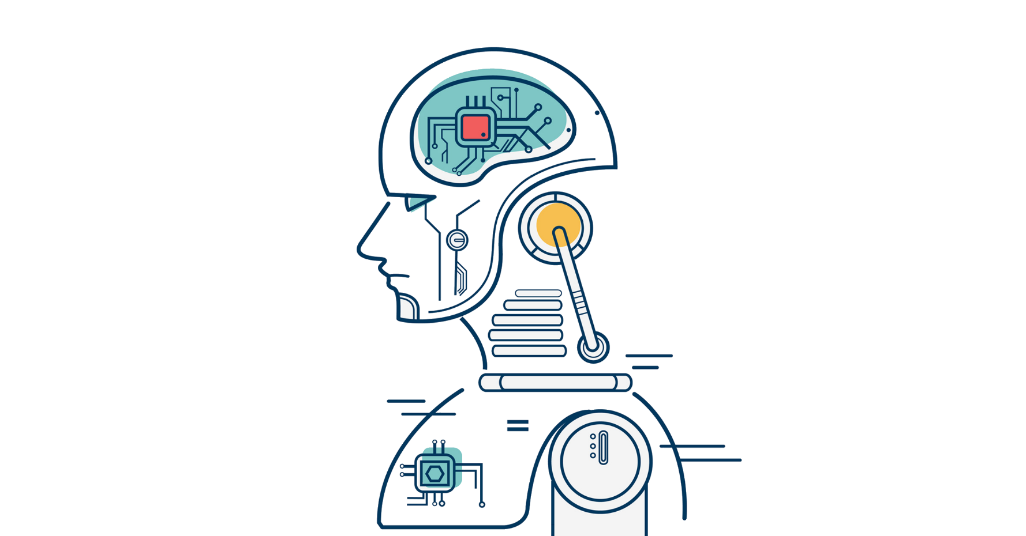
Thank you..

